Slide 1
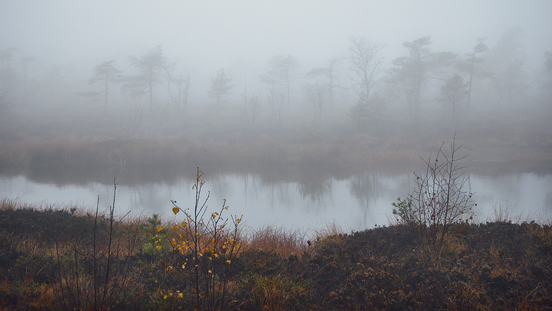
Macbeth
Act 1

Slide 2
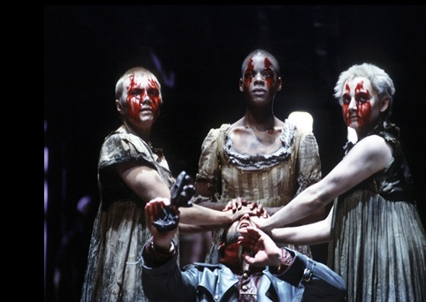
Act 1, Scene 1
As a storm rages, three witches appear, speaking in rhyming, paradoxical couplets: "when the battle's lost and won" (1.1.4); "fair is foul, and foul is fair" (1.1.10). They agree to meet again on the heath (plain) when the battle now raging ends. There they'll meet Macbeth.
The witches' rhyming speech makes them seem inhuman, ominous, and paranormal, which, in fact, they are.
Discuss:
What effect does this have on our expectations of the play?
What themes does this introduce?
Notes:
Themes: Fate and Nature and the unnatural. Literary devices: Paradox

Slide 3
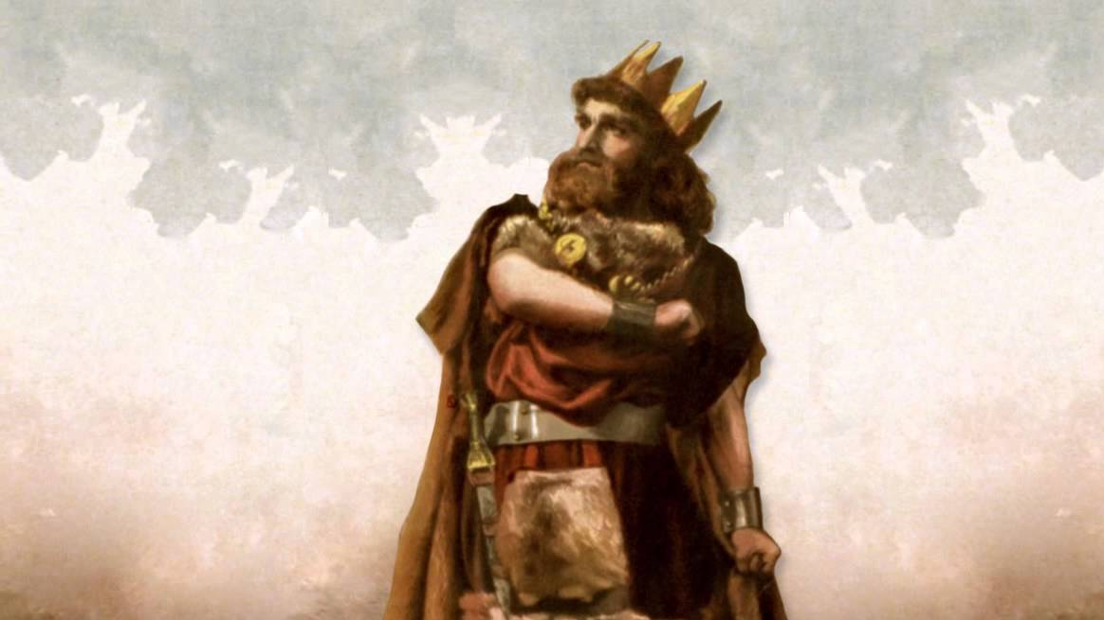
Act 1, Scene 2
At a military camp, King Duncan of Scotland, his sons Malcolm and Donalbain, and the Thane of Lennox wait for news of the war. A captain enters, covered in so much blood he is almost unrecognizable. The captain tells them of the state of the battle against the invading Norwegians and the Scottish rebels Macdonald and the Thane of Cawdor. Two Scottish nobleman have been especially brave, Macbeth (the Thane of Glamis) and Banquo. Macbeth killed Macdonald ("unseamed him from the nave to th' chops" (1.2.22)).
The blood covering the captain makes him an unrecognizable monster, just as Macbeth, who in this scene is described as a noble hero who is brave and loyal to his king, will be transformed into a monster as he becomes "covered" with the metaphorical blood of those he kills to achieve his ambitions.
The Thane of Ross arrives, and describes how Macbeth defeated Sweno, the Norwegian King, who now begs for a truce. Duncan proclaims that the traitorous Thane of Cawdor shall be put to death, and that Macbeth shall be made Thane of Cawdor.
Duncan rewards and trusts his subjects. This is the opposite of personal ambition. Ironically, though, he replaces one traitor with a much worse traitor.
Activity:
Discuss how allusion and foreshadowing work within this scene (Allusions in this scene reference Roman goddesses).
Consider the influence of Roman and Greek mythology in Shakespearean literature. What purpose do they serve?

Slide 4
Act 1, Scene 3
On the heath the witches appear. They call themselves the "weird sisters" (1.3.30) and brag of their dread and magical deeds such as killing swine and cursing a sailor to waste away.
The witches are established as both wicked and magically powerful.
Macbeth and Banquo enter. The witches hail Macbeth as Thane of Glamis, Thane of Cawdor, and "king hereafter" (1.3.47). Banquo asks Macbeth why he seems to fear this good news, then questions the witches about his own future. They say that Banquo is "lesser than Macbeth and greater" (1.3.63) because though he'll never be king, his descendants will.
Does the fear Banquo notes in Macbeth signal that Macbeth's doomed struggle against his ambition starts the instant he hears the prophecy?
Macbeth asks how the witches know this information. But the witches vanish, making the two men wonder if they could have imagined the whole thing. Just then, Ross and Angus enter. They tell Macbeth that the old Thane of Cawdor was a traitor and that Duncan has made Macbeth the new Thane of Cawdor.
The prophecy is fulfilled and the witches' power is proved to be genuine. The traitorous old Thane of Cawdor is replaced by Macbeth.
Macbeth and Banquo are shocked. Macbeth asks Banquo if he now thinks that his children will be king. Banquo seems unsure, and comments that "instruments of darkness" sometimes tell half truths to bring men to ruin.
Banquo guesses the witches' plot exactly. This means that when Macbeth chooses to believe the witches and act, he knows the risks.
Literary devices: foreshadowing, motif, imagery, metaphor and paradox.

Slide 5
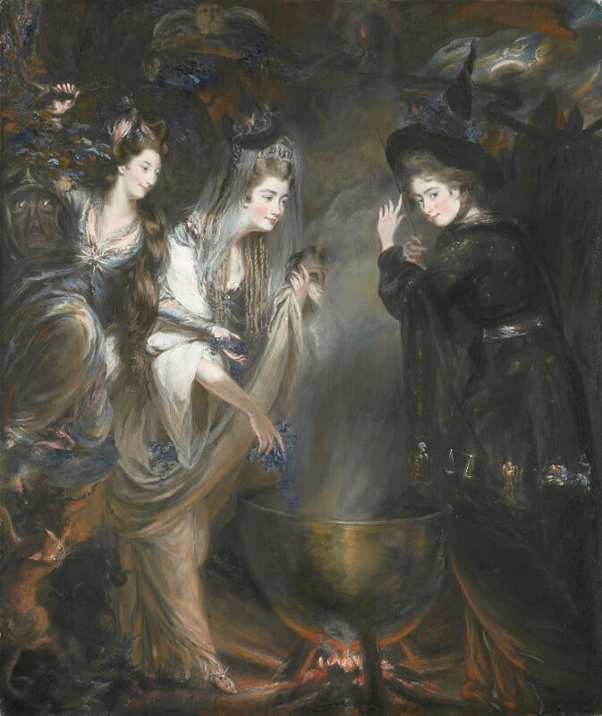
Fate
Much of the first act explores the theme of fate.
Reflection:
What are your personal opinions of “fate”? Do you believe fate is real?
In a literary world where fate is real, are characters truly responsible for their own actions?
Can we manifest “fate” through belief and actions?

Slide 6
Act 1, Scene 4
At a camp near the battlefield, Malcolm tells Duncan that the old Thane of Cawdor confessed and repented before being executed. Duncan notes that you can't always trust a man by his outward show. Macbeth, Banquo, Ross, and Angus enter. Duncan says that even the gift of Cawdor is not as much as Macbeth deserves. Macbeth responds: "The service and loyalty I owe, in doing it, pays itself" (1.4.22).
Deeply ironic that just as Duncan comments about how you can't trust people's outward shows, Macbeth enters. Duncan's great strength as a king is his trust in his people and his thanes, but it also makes him vulnerable to treachery.
Duncan is pleased. He says: "I have begun to plant thee, and will labour to make thee full of growing" (1.4.28-29). Next, he announces that Malcolm will be heir to the Scottish throne (the kingship was not hereditary in Scotland at that time). Duncan then adjourns the meeting and decides to spend the night at Inverness, Macbeth's castle.
Duncan thinks of his role as King in terms of what he can give. He's like a gardener in nature; putting his country above his own desires...
Macbeth goes ahead to prepare for the King's visit, but notes that Malcolm now stands between him and the throne. He begs the stars to "hide your fires, let not light see my black and deep desires" (1.4.51).
...Macbeth, in contrast, thinks in terms of what he can take. This makes his relationship with nature adversarial.
Themes: ambition, fate, natural and the unnatural

Slide 7
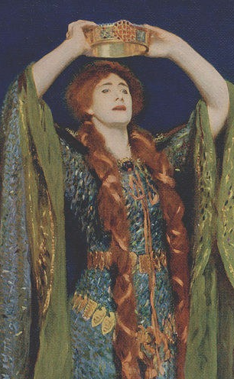
Act 1, Scene 5
At Inverness, Lady Macbeth reads a letter in which Macbeth tells her of the witches' prophecy. Lady Macbeth worries Macbeth is too kind and honourable to fulfill his ambition and the prophecy. She decides to question his manhood to make him act.
Lady Macbeth is established as power-hungry. She sees honour as a weakness, and knows how to push her husband's buttons: question his courage. (fate, ambition, manhood).
A servant enters with news that Duncan will spend the night, then exits. Lady Macbeth says Duncan's visit will be fatal, and calls on spirits to "unsex me here… and take my milk for gall" (1.5.39-46).
In order to murder Duncan, Lady Macbeth not only renounces her womanhood, she literally asks to be turned into an unnatural fiend! (fate, ambition, nature versus unnatural, violence, manhood).
Macbeth enters, and says Duncan will spend the night and leave the next day. Lady Macbeth says Duncan will never see that day. She counsels Macbeth to look like an "innocent flower," but be the viper hiding beneath it (1.5.63). Macbeth remains unconvinced. Lady Macbeth tells him to leave the plan to her.
Macbeth is still struggling against his ambition. Lady Macbeth's advice on how to hide one's true intentions involves exploiting nature. (Note: in the Garden of Eden, the devil hid himself in the form of a snake.) (fate, violence, natural versus unnatural)

Slide 8
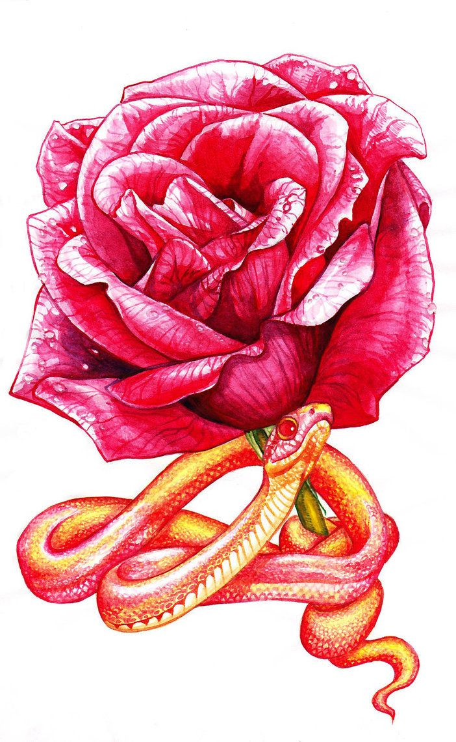
Allusion and metaphor in Scene 5
Explanation and Analysis—Serpents:
Images of serpents appear several times throughout Macbeth. In some instances, this motif seems to represent the theme of treachery, but Shakespeare also uses it to symbolize the concept of lineage.
In Act 1, Scene 5, Lady Macbeth encourages Macbeth to play the part of the gracious host when Duncan arrives at Inverness:
Lady Macbeth: Look like th’ innocent flower, But be the serpent under ’t
Analysis: explore the effect and meaning behind the Biblical allusion in Scene 5.

Slide 9
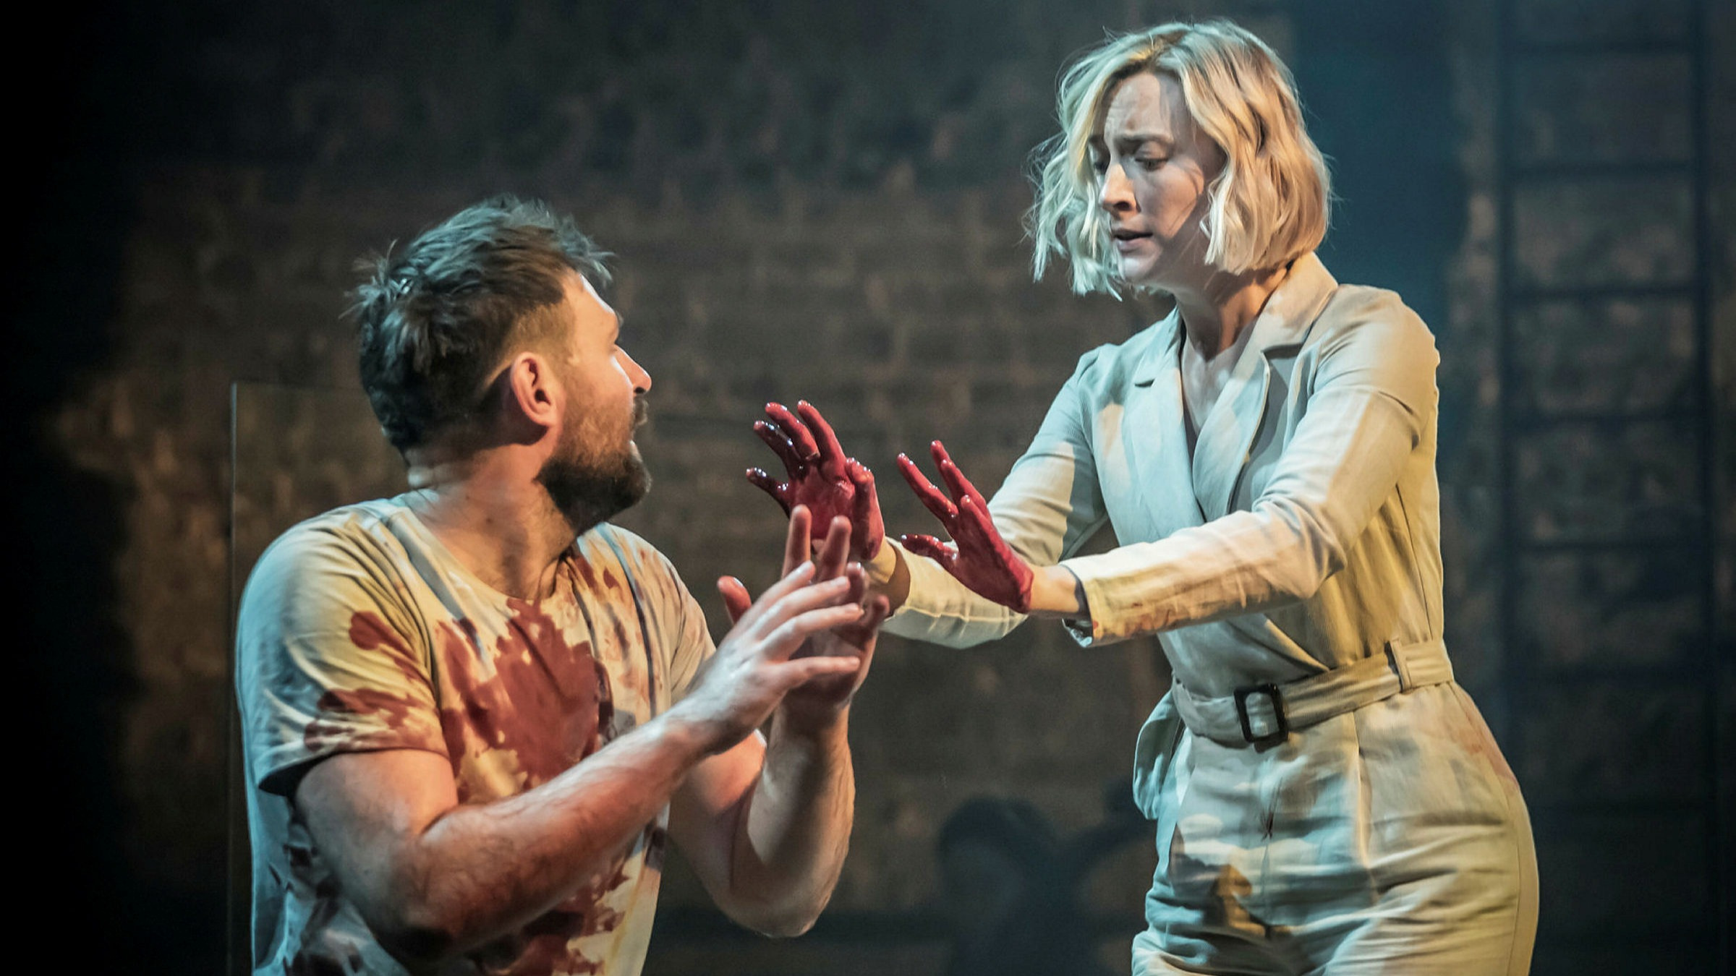
Act 1, Scene 6
Duncan, Malcolm, Donalbain, Banquo, Lennox, Macduff, Ross, and Angus arrive at Inverness. Duncan comments on the sweetness of the air. Banquo notes that martlets, a species of bird that usually nests in churches, have nested in the castle.
It is ironic that Duncan thinks the castle where he'll be murdered is beautiful. The beauty of the castle, and the way it seems blessed by nature with sweet air and nesting birds, also shows what Macbeth loses when he gives in to his ambition to commit the unnatural act of murder. (Natural versus unnatural)
Lady Macbeth warmly greets the King and the thanes, though Macbeth is nowhere to be seen.
At this point, the planned murder weighs more on Macbeth than on Lady Macbeth. (Manhood)

Slide 10
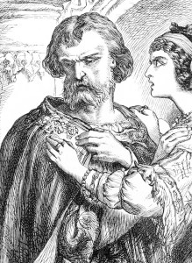
Act 1, Scene 7
Macbeth, alone, agonizes about whether to kill Duncan. He'd be willing to murder Duncan if he thought that would be the end of it. But he knows that "bloody instructions, being taught, return to plague the inventor" (1.7.10). Also, Macbeth notes, Duncan is a guest, kinsmen, and good king. He decides ambition is not enough to justify the murder.
Macbeth wrestles with his ambition and wins! He knows that murdering Duncan will only end up leading to more bloodshed, and ruin his honour, which he prizes. (ambition, violence, manhood).
Lady Macbeth enters, asking where he's been. Macbeth tells her they won't murder Duncan. She questions his manhood. Macbeth replies: "I dare do all that may become a man; who dares do more is none" (1.7.46-47). But Lady Macbeth continues, mocking Macbeth's fickleness: she says she has loved and nursed a baby, but she would have sworn to "das[h] the [baby's] brains out" (1.7.56) if her oaths were as worthless as Macbeth's.
Lady Macbeth and Macbeth debate about manhood and courage. She says it's taking what you want. He says it's the power to put responsibility before selfishness, the power to not take what you want. (ambition, violence, manhood).
Macbeth asks what will happen if they fail. Lady Macbeth assures him they won't fail if they have courage. She outlines the plan: she'll give Duncan's bedroom attendants enough wine to ensure they black out from drunkenness. Then she and Macbeth will commit the murder and frame the attendants. Macbeth, impressed by her courage, agrees.
Lady Macbeth's tragedy is that she doesn't realize that murdering Duncan will torment and ultimately destroy her. Macbeth's tragedy is more profound: he does realize it, and still gives in to his ambition. (fate, ambition, violence).

Slide 11
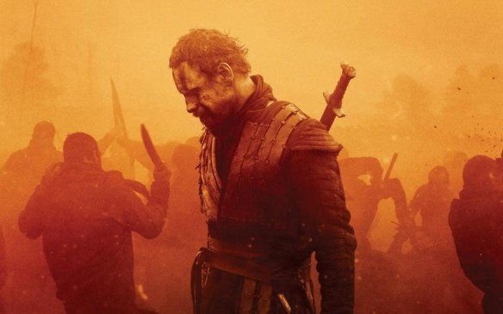
In summary
Act 1 establishes the unnatural, paradoxical nature of the play. It introduces the theme of fate, as well as ambition, manhood, and violence.
In keeping with the complex characterisation in Shakespearean plays, Macbeth wrestles with his conscience and experiences inner turmoil.
Biblical and Roman allusions abound, reflecting the moral questions posed in the first act.
The idea of manhood and womanhood are twisted and perverted through the Macbeth’s actions and conversations.

